Slide 1
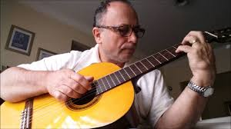
The Impossible Dream
By Joe Darion
utube.com(google images)
Joe Darion (1911-2001)
a popular songwriter and author
he was educated at city college of New York.
he has to his credit scores of famous lyrics for broadway musicals including super hits like ‘Shinbone Alley’ and ‘Man of La Mancha.

Slide 2
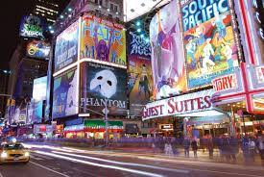
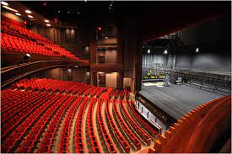
Broadway Theatre NYC - East Village Apartments New York
Eastvillageapts.bysudha.com
(google images)
britannica.com (google images)
Broadway theatre, also simply known as Broadway, refers to the theatrical performances which are presented in the 41 professional theatres, each with 500 or more seats, located in the Theater District and the Lincoln Center along Broadway, in Midtown Manhattan, New York City.

Slide 3
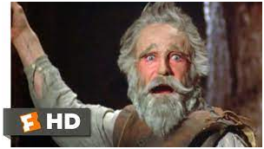
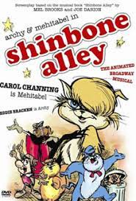
· ‘Man of La Mancha is a 1972 film adaptation of the Broadway Musical.
https://www.youtube.com/watch?v=OHVGOp5Usv4
youtube.com (google images)
Shinbone Alley is a 1970 animated musical comedy film.
Shinbone Alley (film) - Wikipedia
En.wikipedia.org (google images)

Slide 4
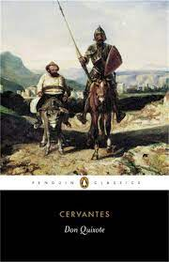
The Impossible Dream
inspired by Don Quixote
google images
The musical ‘The Impossible Dream’ was inspired by Don Quixote.
Don Quixote is a Spanish classical novel written by Miguel De Cervantes.
In this novel Cervantes is highly critical of Knighthood and makes fun of the tradition of Knights.

Slide 5
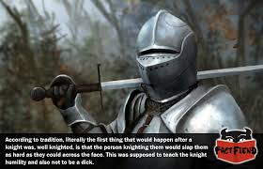
The Tradition of Knighthood
A knight is a person granted an honorary title of knighthood by a head of state (including the pope) or representative for service to the monarch, the church or the country, especially in a military capacity. (wiki)
Knights were known for their masterful skills with horses. A knight's code of conduct included: mercy, humility, honor, sacrifice, faithfulness, courage, utmost graciousness and courtesy toward women (chivalry) (medievaltime.com)
Factfiend.com (google images)

Slide 6
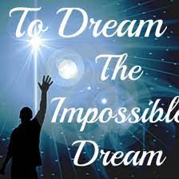
The Impossible Dream
In this musical, the speaker is the knight who urges us to set out on our unquenchable quest to add some measure of grace to the world.
smule.com (google images)

Slide 7
The Poem
Stanza II
To right the unrightable wrong
To love pure and chaste from afar
To try when your arms are too weary
To reach the unreachable star
Stanza I
It is the mission of each true knight…
His duty… nay, his privilege!
To dream the impossible dream
To fight the unbeatable foe
To bear with unbearable sorrow
To run where the brave dare not go

Slide 8
Stanza III
This is my quest
To follow that star
No matter how hopeless
No matter how far
Stanza IV
To fight for the right
Without question or pause
To be willing to march into Hell
For a heavenly cause

Slide 9
Stanza V
And I know if I'll only be true
To this glorious quest
That my heart will lie peaceful and calm
When I'm laid to my rest.
(laid to rest : buried after death)
Stanza VI
And the world will be better for this
That one man, scorned and covered with scars
Still strove with his last ounce of courage
To reach the unreachable star
(scorned: laughed at)
(scars: marks of injury)

