Slide 1
Mitosis by Vijayshree Hemke

Slide 2
INTRODUCTION
Mitosis is the final phase of the cell cycle .
It is a relatively short phase. Mitosis occupies approx. 10% of the total cell cycle time of a typical human proliferative cell.
In M phase actual cell division or mitosis occurs.
Interphase represents the phase between two successive M phases.
It is significant to note that in the 24 hrs. average duration of cell cycle of human cell, cell division proper lasts more than 95% of the duration of cell cycle.
Mitosis starts with karyokinesis and usually end with cytokinesis.
Root tip is the best material to study mitosis. Acetocarmine is the stain used for it.

Slide 3
Mitosis
Mitosis is a mode of cell division in which the daughter cells are genetically similar to the mother cell because their nuclei come to have the same number and type of chromosome as are present in the mother cell.
Mitosis occur during formation body cells both diploid and haploid in plants and mostly diploid in animals.
Its therefore, also called somatic cell division.
As the daughter cell resemble their mother cell genetically, mitosis is also called equational division.
It occurs in almost all cell during growth of embryo. Later on it occurs in some specific regions like skin and bone marrow in animals. And meristems in plants (stem apex, root apex, intercalary and lateral meristems).

Slide 4
(A) Karyokinesis
Its is the stage of nuclear division (indirect nuclear division ) which is continues but is divided into four stages.
1. Prophase 2. Metaphase
3. Anaphase 4. Telophase

Slide 5
1-prophase
Longest phase of karyokinesis.
In early prophase or spireme stage.
The chromatin fibers condense through spiraligation to form elongated chromosomes.
There is increased viscosity and refractivity of cytoplasm.
The ends of chromosome are not distinguishable.
The nucleus appears as a ball of wools .
Centrosome has already divided . The daughter centrosomes begin to move away from each others.

Slide 6
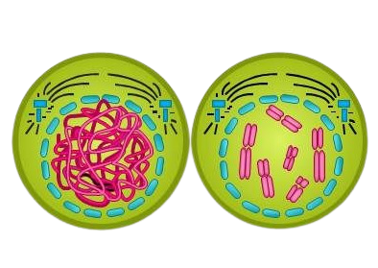
Spindle fibers
Astral ray
Centriole
Cytoplasm
Nuclear Membrane
Nuclear Membrane
Chromatids
Prophase

Slide 7
In mid prophase, chromosomes shorten and become distinct with each having two chromatids attached to narrow point called centromere.
The centrosome develop astral rays and farther.
In late prophase , the centrosomes reach the poles, form asters and begin to develop spindle fibres.
Nucleolus degenerates and nuclear envelope starts breaking.
Golgi apparatus and endoplasmic reticulum diminish.
In plants cells centrosomes are absent spindle fibres develop without them. Polar end is negatively charged they are organized in both plants animals with the help of calcium ion containing protein calmodulin.
Completion of prophase is marked by , a) condensation of chromosomal material or chromatin into mitotic chromosomes. b) each chromosome has two chromatids attached in the region of centromere. C) formation of mitotic spindle.

Slide 8
2-Metaphase
Chromosomes are the shortest and thickest in metaphase.
Each chromosome gets attached to two spindle fibres or chromosome fibres, one from each pole, in the region of its kinetochores.
Chromosome or kinetochore fibres contract and bring the chromosomes over the equator.
The phenomenon is called congression .
Centromeres of all the chromosomes are present over the equator.
Therefore, chromosomes form a sort of apparent plate called equatorial plate or metaphasic plate.
Metaphse is the best stage to see the chromosomes.

Slide 9
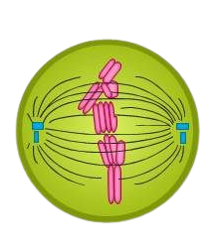
Spindle fibers
Astral ray
Centriole
Chromatids
Cytoplasm
Metaphase

Slide 10
3- Anaphase
It is the phase of shortest duration.
APC (anaphase promoting complex) develops.
It degenerates proteins binding the two chromatids in the region of centromere. As a result, the centromere of each chromosome divides.
This converts the two chromatids into daughter chromosomes each being attached to the spindle pole of its side by independents chromosomal or kinetochore fibre.
Anaphase has two stages; Anaphase A and Anaphase B
Anaphase B is also called spindle elongation phase as the two spindle poles move away from one another.

Slide 11
In anaphase A chromosomes move towards the spindle poles with the centromeres projecting towards the poles and limbs trailing behind.
There is corresponding shortening of chromosome fibres.
Anaphasic chromosomes appeared differently depending upon the position of their centromeres – V-shaped (metacentric), L- shaped (submetacentric), J- shaped ( acrocentric) and I- shaped (telocentric).
The two pole-ward moving chromosome of each type remain attached to each other by interzonal fibres.
Ultimately, two groups of chromosomes come to lie at the spindle poles.

Slide 12
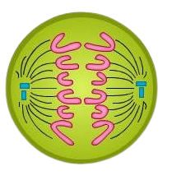
Sister chromatids
Spindle fiber
Centriole
Spindle fiber
Cytoplasm
Anaphase

Slide 13
4 -Telophase
It is the stage of reconstitution of nuclei .
Chromosomes uncoil, elongate , loose their stainability and form chromatin fibres.
Nucleolar organisers form nucleoli in one or more pairs of chromosomes.
Nucleoplasm and nuclear envelop appear so that two daughter nuclei are formed.
Golgi apparatus and endoplasmic reticulum begin to grow.

Slide 14
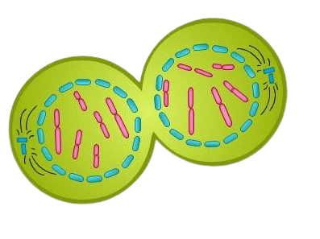
Telophase
Daughter cells
Centriole
Nuclear envelope reappears
Chromosomes
Two daughter nuclei

Slide 15
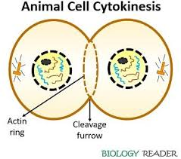
(B) Cytokinesis
Cytokinesis (Gk. Kytos-cell, kinesis-movement ) is division of cell having undergone karyokinesis to produce two daughter cells each with daughter nucleus
It begins in mid anaphase and is generally completed along with the completion of telophase.
Animal cell cytokinesis is different from plant cell cytokinesis.

Slide 16
Importance of Mitosis
For Growth of cells.
Repairing of cells.
Maintenance of chromosome number.
Maintenance of Surface / Volume ratio
Maintenance of Nucleocytoplasmic ratio.
For reproduction.
Opportunity for differentiation.
Somatic mutations.

Slide 17
Thank you

