Slide 1
Changes During muscle Contraction:
Various changes have been Observed and studied during muscular contraction.

Slide 2
Muscle Twitch:-
The response of a muscle to single short stimulus, such as an electric shock, is known as Twitch.
It can be recorded by kymograph.
A twitch can be divided in to three successive phases;
* Latent phase or period :-
It is brief time interval between the point of stimulation and actual starting of response i.e. Contraction phase.
The duration of the latent period varies with the species, type of muscle, temprature and internal condition of muscle.

Slide 3
Latent period is due to time taken:
For propagation of impulse from the point of stimulation to the neuromuscular junction and hence to the sarcolema.
For initiation of contraction.
It lasts about 10 milliseconds (0.01 sec)

Slide 4
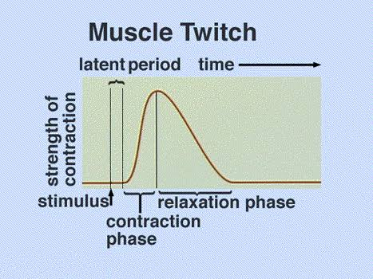
*Contraction phase:
It is the time interval in which the muscle reaches the peak of contraction and performs work.
i.e. From the beginning of the contraction up to the maximum contraction.
It lasts about 40 milliseconds (0.04 sec).

Slide 5
* Relaxation phase:
It is the longest of the three phases, it lasts about 50 milliseconds (0.05 sec).
It is indicated by the downward tracing in the myogram ( kymogram)
Kymogram – graph showing a twitch contraction.
During this phase, the muscle return to it’s original length.

Slide 6
Tetanus:-
If the muscle fibre is stimulated before it relaxes, for a second time, it can contract again. If we continue closely spaced stimuli, we get a smooth sustained contraction, called a tetanus or tetanic contraction.
Whose tension may be much greter than that developed by the single twitches.

Slide 7
If frog muscle is stimulated at a rate of 20 to 30 stimuli per second, the muscle can only partly relax between stimuli. As a result, the muscle maintains a sustained contraction called incomplete tetanus.
Increased stimuli at a rate of 35 to 50 stimuli per second result in complete tetanus, that lacks even partial relaxation.

Slide 8
Summation:-
If a second stimulus is applied to muscle that is still in the contraction phase, second contraction is added to the first and results in the greater shortening of the muscle than caused by a single stimulus. This is the summation.

Slide 9
Fatigue:-
When repeatedly stimulated, the muscle loses its irritability and becomes gradually less excitable and ultimately ceases ( stop) to respond. This phenomenon is called fatigue.
So it can be defined as the inability of muscle to do further work.
The fatigue may be due to;
Exhaustation of sources of energy of the muscle.
Accumulation of the end products of chemical reactions such as lactic acid, carbon dioxide, keton bodies.
Decrease of local synthesis of acetylcholine during prolonged exercise.

Slide 10
Rigor mortis:-
This is the muscular contraction that take place after death.
It is well known fact that soon after death the body passes in to rigor mortis or the so- called stiffening of death.
It shows the following changes;
Loses the excitability.
Shortens in length.
Increases in thickness.
Becomes viscous and loses translucency.
Becomes distinctly acidic ( PH-5.8).
The muscle gives off carbonic acid.

Slide 11
The time of onset is not the same in all animals. On an average rigor mortis starts in the second hour and is completed in three hours after death.

Slide 12
All- or none law:-
The response of a muscle fibers is independent of the type, or strength of the stimulus.
It means that if a single muscle fibers contracts at all, it will contract to its maximum.
This law is not applicable for the whole muscle, which is made of several fibres.
In this case, as the strength of the stimulus is increased, more and more muscle fibers will be affected and the degree of contraction will be raised and a stage will be achieved where there is no further rise. This is all or none law for the whole muscle.

Slide 13
Isometric and Isotonic Contraction:-
The force exerted by a contracting muscle on an object is known as muscle Tension and the force exerted on the muscle by the object is the load.
The muscle tension and load are opposing forces.
Whether or not contraction produces movement depends on the magnitude of the tension produced by the muscle.

Slide 14
When a muscle develops tension but does not change length, then the contraction is said to be isometric ( constant length). Isometric literally means ‘same length’, where iso- means ‘the same ‘and ‘metric’ refers to ‘lenght’
In contrast, a tension on the muscle remains constant but the muscle length is changing is said to be Isotonic contraction ( constant tension).
Isotonic literally means 'same tension,' where 'iso'- means 'the same' and 'tonic' refers to 'tension or force’
When a muscle is stimulated, first isometric contraction occurs, then Isotonic contraction follows, that is, tension is developed first then the muscle shortens.

