Slide 1
Structure and Symmetry of Viruses
Cultivation of Viruses
Mr. S. N. Mendhe
Department of Microbiology,
Shri Shivaji Science and Arts College, Chikhli

Slide 2
Viruses
Long before the discovery of the microbial world, the term virus was used to denote any agent capable of producing disease. The word is Latin one & originally meant snake venom or poisonous fluid.
Now viruses are defined as obligate intracellular parasitic minute organisms. Almost all the types of living organisms are subject to attack by viruses, hence, viruses occur in plants, animals even in bacteria.

Slide 3
General characteristics or General properties
Size & visibility
Filterability
Simple structure
Absence of cellular structure
No independent metabolism
Nucleic acids
Crystallization
No growth & division

Slide 4
Size & visibility :-
Viruses vary widely in size. The largest among them (e.g., poxviruses) measuring about 300. The smallest viruses (e.g. foot & mouth disease virus ) are about 20nm.
On the whole viruses are much smaller than bacteria.
Mostly animal viruses, plant viruses & bacteriophages are invisible under the light microscope. As they are too small to be seen under the light microscope, they are also designated as ultramicroscopic.
One of the larger viruses such as pox viruses, can be seen under the light microscope

Slide 5
Filterability:-
Iwanowski demonstrated what was thought to be uniquely distinctive property of viruses, the ability when suspended in fluid to pass through the filters that would hold back bacteria. Hence they are also known as filterable viruses.

Slide 6
Simple structure:-
Viruses have very simple structures. The simplest viruses are nucleoprotein particles consisting of genetic material (DNA or RNA) surrounded by protein capsid.
In this respect they differ from typical cells which are made up proteins, carbohydrates, lipids & nucleic acids. The most complex viruses contain lipids & carbohydrates.
Absence of cellular structure:-
Viruses do not have any cytoplasm, thus cytoplasmic organelles like mitochonria, golgi complex, ribosomes etc. are absent. They do not have limiting cell membrane.

Slide 7
No independent metabolism:-
Viruses can not multiply outside a living cell. No virus has been cultivated in cell free medium.
Viruses do not have independent metabolism. They are metabolically inactive outside the host cell, because they do not posses enzyme systems & protein synthesis machinery.
Viral nucleic acid replicate by utilizing protein synthesis machinery of the host. It codes for the synthesis of a number of viral proteins including subunits or capsomeres of the capsomeres tail proteins & some enzymes concerned with the synthesis or release of virions.

Slide 8
Nucleic acids:-
Virions have only one nucleic acid, either DNA or RNA. Typical cells have both DNA & RNA.
Crystallization:- Many of the smaller viruses can be crystallized & thus behave like chemicals.
No growth & division:- Viruses do not have power of growth & division. A fully formed virus does not increase in size by addition of new molecules.

Slide 9
Viral structure:-
Viruses are ultramicroscopic particles containing nucleic acid surrounded by protein, and in some cases, other macromolecular components such as a membrane like envelope.
Outside the host cell, the virus particle is also known as a virion. The virion is metabolically inert and does not grow or carry on respiratory or biosynthetic functions.
Viral structure:- Certain viruses contain ribonucleic acid (RNA), while other viruses have deoxyribonucleic acid (DNA).
The nucleic acid portion of the viruses is known as the genome. The nucleic acid may be single-stranded or double-stranded; it may be linear or a closed loop.

Slide 10
The genome of the virus is surrounded by a protein coat known as a capsid, which is formed from a number of individual protein molecules called capsomeres.
Capsomeres are arranged in a definite geometrical pattern around the nucleic acid. A single type of capsomere or several chemically distinct types may make up the capsid.
The combination of genome and capsid is called the viral nucleocapsid. Such viruses are known as naked viruses, e.g. Polio virus, Adeno virus.
A number of kinds of viruses contain envelopes. An envelope is a membrane like structure that encloses the nucleocapsid and is obtained from a host cell during the replication process. Among the enveloped viruses are those of herpes simplex, chickenpox, and infectious mononucleosis.

Slide 11
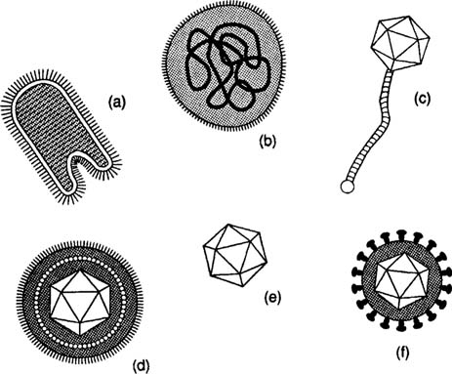

Slide 12
Helical / Spiral Symmetry:-The nucleocapsids of viruses are constructed according to certain symmetrical patterns. The virus that causes tobacco mosaic disease, for example, has helical symmetry. In this case, the nucleocapsid is wound like a tightly coiled spiral. The rabies virus also has helical symmetry.
Icosahedral Symmetry:- Other viruses take the shape of an icosahedron, and they are said to have icosahedral symmetry. In an icosahedron, the capsid is composed of 20 faces, each shaped as an equilateral triangle. Among the icosahedral viruses are those that cause yellow fever, polio, and head colds.

Slide 13
The envelope of certain viruses is a lipid bilayer containing glycoproteins embedded in the lipid. The envelope gives a somewhat circular appearance to the virus and does not contribute to the symmetry of the nucleocapsid.
Projections from the envelope are known as spikes. The spikes sometimes contain essential elements for attachment of the virus to the host cell.

Slide 14
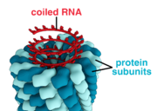

Slide 15
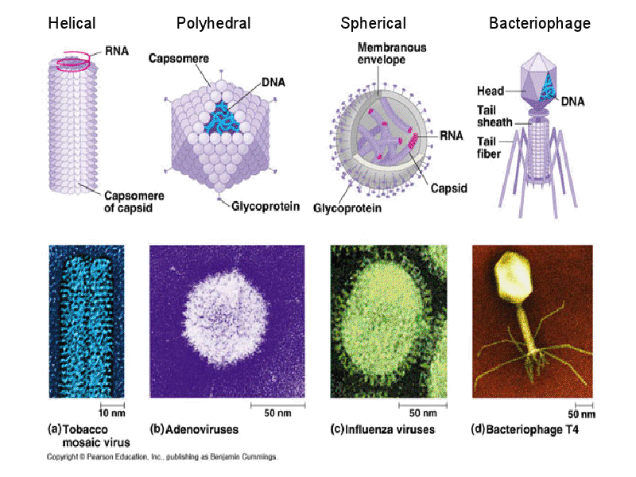

Slide 16
Binal /Complex Symmetry:- These viruses possess a capsid that is neither purely helical nor purely icosahedral, and that may possess extra structures such as protein tails or a complex outer wall.
Some bacteriophages, such as Enterobacteria phage T4, have a complex structure consisting of an icosahedral head bound to a helical tail, which may have a hexagonal base plate with protruding protein tail fibres.

Slide 17
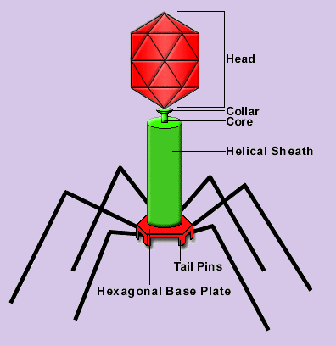

Slide 18
CULTIVATION OF VIRUSES:-
Viruses are obligate intracellular parasites. They cannot grow in any culture media.
There are three methods are used for the cultivation of the viruses:
Animal inoculation
Tissue culture
Embryonated egg inoculation

Slide 19
1. Animal inoculation:-
As the name indicates cultivation of viruses occur by using different types of animals. For e.g. Monkeys, rats, rabbits guinea pigs.
At the end of incubation period, the animals are slaughtered and washed thoroughly and viruses are obtained from them.

Slide 20
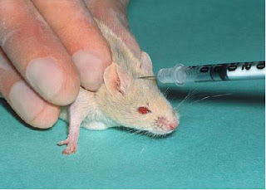

Slide 21
2.Embryonated eggs( Chick embryo method):-
Prior to the advent of cell culture, animal viruses could be propagated only on whole animals or embryonated chicken eggs.
The developing chick embryo, 10 to 14 days after fertilization, provides a variety of differentiated tissues, including the amnion, allantoic cavity, chorion, and yolk sac, which serve as substrates for growth of a wide variety of viruses, including orthomyxoviruses, paramyxo viruses, rhabdoviruses, togaviruses, herpes viruses, and pox viruses.
The shell surface is first disinfected with iodine and penetrated with a small sterile drill. After inoculation, the drill hole is sealed with paraffin wax and the egg is then incubated at 36 ⁰C for required period of time.

Slide 22
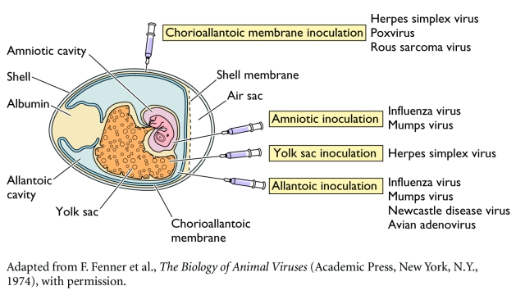

Slide 23
3. Tissue culture method:-
This is the method of choice routinely employed for cultivation of viruses.
a) Cell culture:-
Tissues, e.g., monkey kidney are broken up with a sterile razor and dissociated into component cells by proteolytic enzyme like trypsin and mechanical shaking.
The cells are washed with physiological buffer and then suspended in a buffered nutrient medium in the presence of blood serum or growth medium

Slide 24
which contains a complex mixture of hormones, essential amino acids, vitamins, salt, glucose and factors required for the growth of normal cells.
Antibiotics are also added for preventing bacterial contamination. The commonly used medium is Hanks or Earles balanced salt solution.
Cell suspension is placed in tissue culture vessel, petri dish, etc and incubated.

Slide 25
Under these conditions, cells will adhere to the surface of the dish, and they will divide and migrate until the surface of the dish is covered with a single layer of cells.
This monolayer, sheet of the cells remains viable and is known as cell line or cell culture.

Slide 26
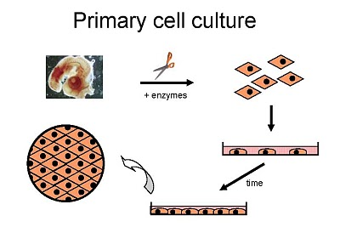

Slide 27
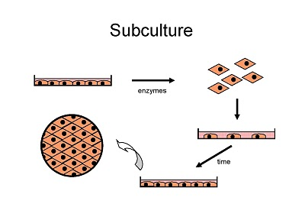

Slide 28
Cell culture:-
Primary cell culture:- A primary cell culture is defined as a culture of cells obtained from the original tissue that have been cultivated in vitro for the first time, and that have not been subcultured.
These are normal cells freshly taken from the body and culture it in.
For Example: Primary cell culture in monkey’s kidney, chick embryo eggs and human embryonic kidney is used.
It is mainly used for cultivation of viruses for the vaccine production and rarely used for isolation of viruses.

Slide 29
Diploid cell culture:-
These are cells of single type that retain their original diploid chromosomal number.
They are capable of 50-100 divisions before dying.
It is mainly used for isolation of viruses and occasionally for the vaccine production.

Slide 30
Continuous cell line:-
These are single types of cell usually derived from cancer cells.
These cells are capable of an infinite number of divisions, e.g., HeLa cell line, Hep-2 cell line, etc.
HeLa cells have been derived from carcinoma of cervix from lady named Heneritta Lacks who had died from cervical cancer.
This cell line is also known as HeLa cell line and still maintained in the laboratory.
It is mainly used for the isolation of viruses. HeLa cell line (Henritta Lacks) is readily available and easy to propagate serially.

Slide 31
Detection of viral growth in cell culture
The viral replication or growth in cell culture is determined by following methods:
1. Cytopathic effect (CPE):
2. Metabolic inhibition:-
3. Haemadsorption:
4. Immunofluorescence:
5. Interference:

Slide 32
1. Cytopathic effect (CPE):
Viruses cause morphological changes or cytopathic lesions in cell culture in which they grow.
These cytopathic lesions are known as cytopathic effects and can be observed under microscope.
Cytopathic effects (CPE) induced by viruses are characteristic, e.g., enteroviuses produce crenation of cells and degeneration of entire cell sheet.

Slide 33
2. Metobolic inhibition:-
The normal cells produce acid during normal metabolism.
However, virus infected cells fail to produce acid due to inhibition of normal cellular metabolism.
This can be detected by use of phenol red indicator in cell culture.
If the virus grows in cell culture, acid production will be stopped and phenol red will not show colour change.

Slide 34
3. Haemadsorption:
In response to multiplication of haemagglutinating viruses in cell culture, adsorption of certain type of erythrocytes on the surface of cells occurs, e.g., Influenza and Parainfluenza viruses.
4. Immunofluorescense:
Immunofluorescence (IF) technique is widely used for the rapid diagnosis of viral infections by the detection of virus antigen in clinical specimens, as well as the detection of virus-specific antibody.
The technique makes use of a fluorescent- labelled antibody to stain specimens containing specific virus antigens, so that the stained cells fluoresce under UV illumination.

Slide 35
5. Interference:
In this technique, the growth of first virus inhibits the growth of second virus by interference, e.g., non cytopathogenic viruses inhibit the growth of cytopathogenic viruses.

Slide 36
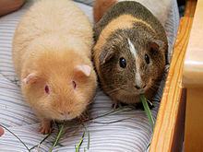
Guineapig-Susceptible animal-

